Slide 1
Earth Month 2024 Webinar: Presidential Energy Policy
Hosted by Colin Teague, Eric Miller & Lauren Keller
Notes:
Hello and welcome to Week 3 of Earth Month with The Energy Co-op. This week, we are looking at the 2024 Presidential Election and each of the presumed candidates’ policies on energy.

Slide 2
Biden’s Energy Policies
Notes:
First, I’ll review incumbent President Joe Biden’s accomplishments toward his renewable energy goals as a first-term president, as well as his proposed energy policies for a second term, going into the 2024 election.
Going into his first term as president, Biden made it clear that his administration viewed the transition to 100% renewable energy as an essential priority, and set several goals to make progress towards a zero-emissions future:

Slide 3
Biden’s Energy Goals
Pass a major climate-friendly stimulus package in the wake of COVID-19
Set a goal to require the production of zero-emissions vehicles only by 2035
Achieve 55% clean electricity generation by 2025 and 100% by 2035
Commit to a 50% reduction in greenhouse gas emissions by 2030 (from 2005 levels)
Notes:
First, I’ll review incumbent President Joe Biden’s accomplishments toward his renewable energy goals as a first-term president, as well as his proposed energy policies for a second term, going into the 2024 election.
Going into his first term as president, Biden made it clear that his administration viewed the transition to 100% renewable energy as an essential priority, and set several goals to make progress towards a zero-emissions future:

Slide 4
Inflation Reduction Act
$2000 tax credit for homeowners installing a new heat pump and a 30% tax credit for installing a residential solar system
Tax credits ranging from $2,500-$7,500 for both individuals and businesses that purchase electric vehicles
292 infrastructure and manufacturing projects and over $100 trillion of investment in renewable energy technology
Notes:
In order to reach the milestones Biden has set, illustrated in bullets 2, 3, and 4, it was crucial for him to successfully pass a stimulus package that included tax breaks incentivizing both the transition to clean energy at the household level, and spurring the development of clean energy manufacturing and infrastructure projects at the commercial level. In 2022, Biden’s Inflation Reduction Act passed, becoming the most significant piece of climate-friendly legislation in U.S. history.
Slide 4: The Inflation Reduction Act (IRA) does several things that enabled the Biden administration to make progress toward their other renewable energy goals:
On the household front, the Inflation Reduction Act offers homeowners a $2000 tax credit for installing a new heat pump and a 30% tax credit for installing a residential solar system.
The IRA offers tax credits ranging from $2,500-$7,500 for both individuals and businesses that purchase electric vehicles.
The above tax incentives have created an increased demand for batteries, solar panels, heat pumps, and electric vehicles, which has in turn prompted 292 infrastructure and manufacturing projects and over $100 trillion of investment in renewable energy technology. The projects encompass the manufacturing of those technologies, along with grid electrification projects, and the development of a growing electric vehicle charging network.

Slide 5
Progress on Electric Vehicles
Biden’s goal of requiring all new vehicles manufactured after 2035 to be emissions-free is on-track
Signed an executive order requiring federal agencies to use 100% emissions-free light duty vehicles by 2027
Set a milestone of having 50% of vehicles sold be emissions-free by 2030
The Inflation Reduction Act has also prompted change in the automobile industry: There were 1.2 million electric vehicles sold in the US in 2023, marking a 43% increase from 2022
Notes:
Thanks to the passage of the Inflation Reduction Act, the Biden Administration has seen promising growth toward some of its other goals.
Biden’s goal of requiring all new vehicles manufactured after 2035 to be emissions-free is on-track: he signed an executive order requiring federal agencies to use 100% emissions-free light duty vehicles by 2027 and set a milestone of having 50% of vehicles sold be emissions-free by 2030. The Inflation Reduction Act has also prompted change in the automobile industry. There were 1.2 million electric vehicles sold in the US in 2023, marking a 43% increase from 2022.

Slide 6
Transitioning to Renewable Electricity
Biden made significant progress towards 100% emissions free electricity in two ways:
Signed an executive order requiring all federal agencies to purchase 100% renewable energy by 2030
Tax credits for renewable electricity generation in the Inflation Reduction Act paved the way for the development of more renewable electricity generation facilities
More renewable energy generation infrastructure must be built to reach 100% renewable electricity by 2035
Notes:
For the most part, Biden’s energy goals for a second term are to continue progress toward the big climate goals he laid out in his first term (and I’ll show them again here):
Set a goal to require the production of zero-emissions vehicles only by 2035
Achieve 55% clean electricity generation by 2025 and 100% by 2035
Commit to a 50% reduction in greenhouse gas emissions by 2030 (from 2005 levels)

Slide 7
Biden’s Goals for a Second Term
Set a goal to require the production of zero-emissions vehicles only by 2035
Achieve 55% clean electricity generation by 2025 and 100% by 2035
Commit to a 50% reduction in greenhouse gas emissions by 2030 (from 2005 levels)

Slide 8
Biden’s Goals for a Second Term
Image: Jay Pizzle
Notes:
That said, there are a few signs that Biden may be slightly backtracking on his commitment to fighting climate change and achieving zero carbon emissions, to attract more moderate voters in the 2024 election.
Biden signed the strictest emissions regulations in history this March, but they included concessions to auto manufacturers and automotive workers’ unions, including a significantly less aggressive timeline, and the allowance of additional low-emissions options like plug-in hybrids and low emissions gas vehicles.
The Biden administration has also slowed down in its quest to enact stricter emissions regulations for existing gas plants, indicating this goal will wait until a hypothetical second term.
It remains to be seen whether Biden will make a renewed push for stricter emissions regulations for both vehicles and power plants in a second term, but it is a certainty that combatting climate change and reducing emissions will be at the center of Joe Biden’s energy policy in the 2024 presidential election.

Slide 9
Former President Trump’s Energy Policy

Slide 10
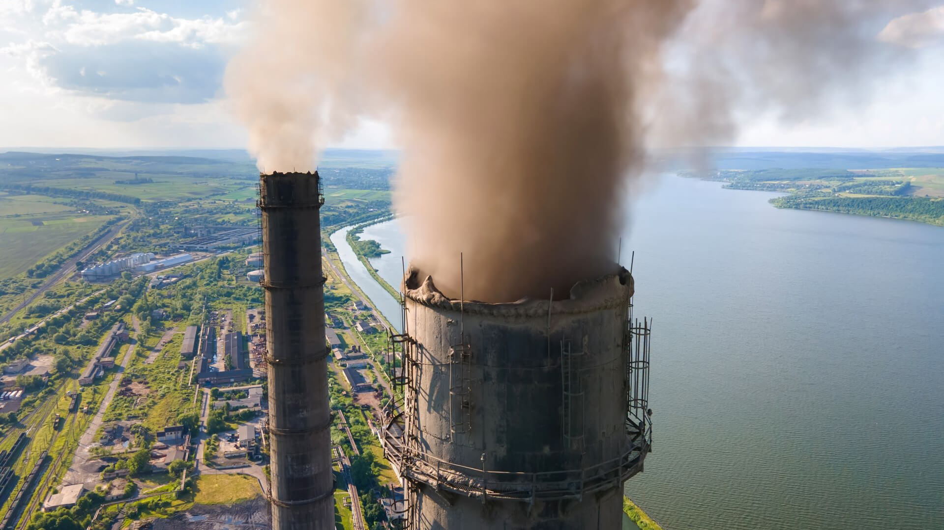
Trump's Energy Strategy
Centered around boosting traditional energy sources (oil, gas, coal)
Emphasized maximizing domestic production for energy security and job creation over carbon emission reductions

Slide 11
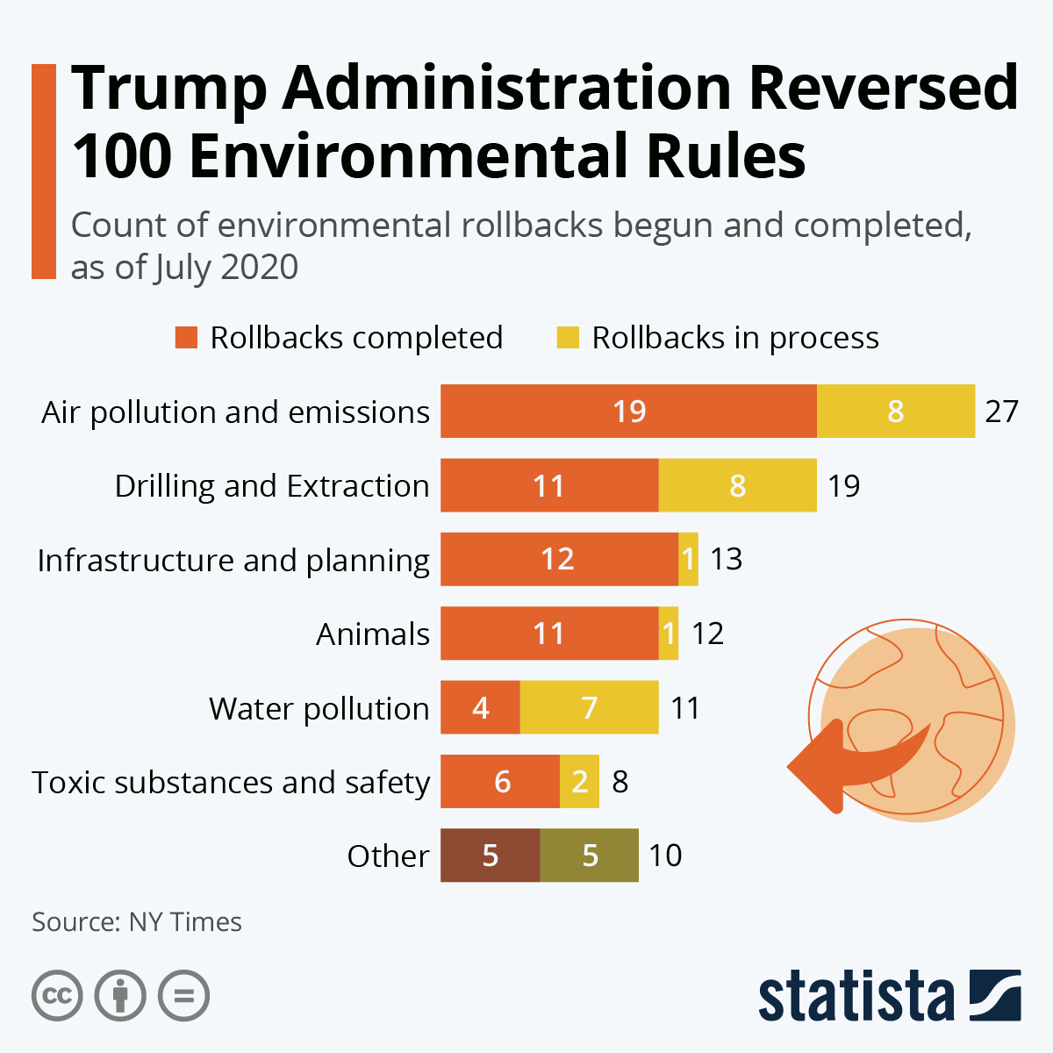
Rollback of Regulations
Then President Trump rolled back regulations affecting the fossil fuel industry
Withdrew from the Paris Climate Agreement citing economic concerns over job losses
Focus on Coal revival

Slide 12
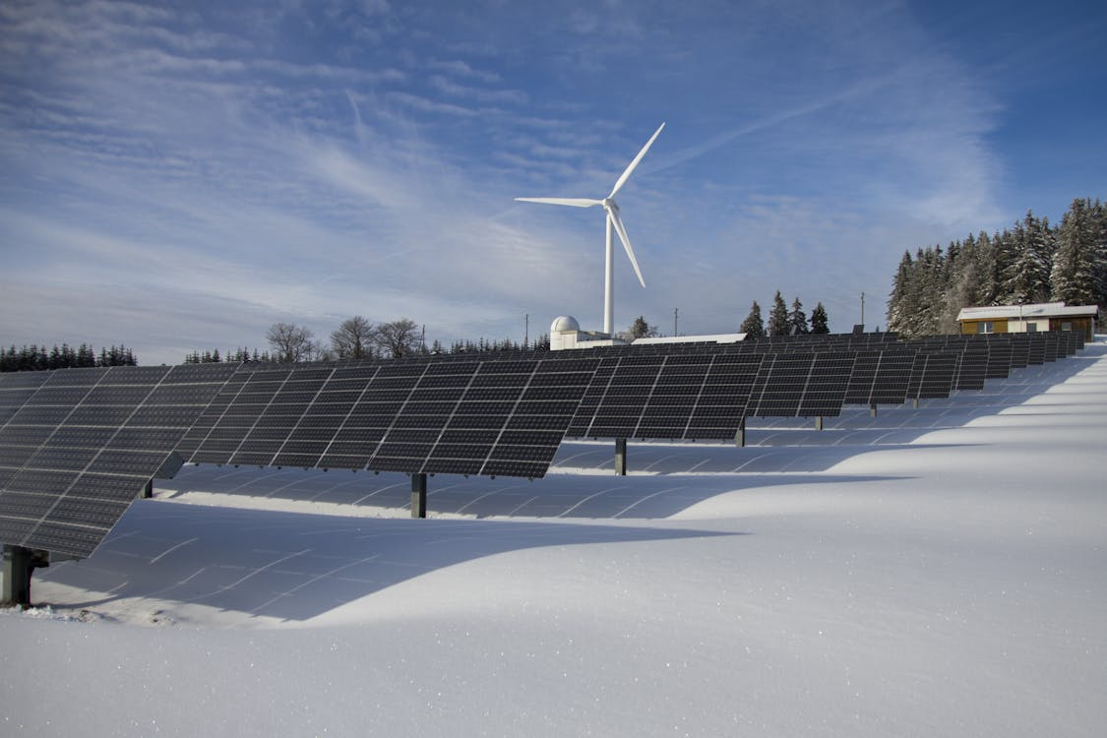
Impact on Renewable Energy
Trump's administration reduced funding for renewable energy programs and incentives
Concerns among clean energy advocates about carbon emissions and climate change

Slide 13
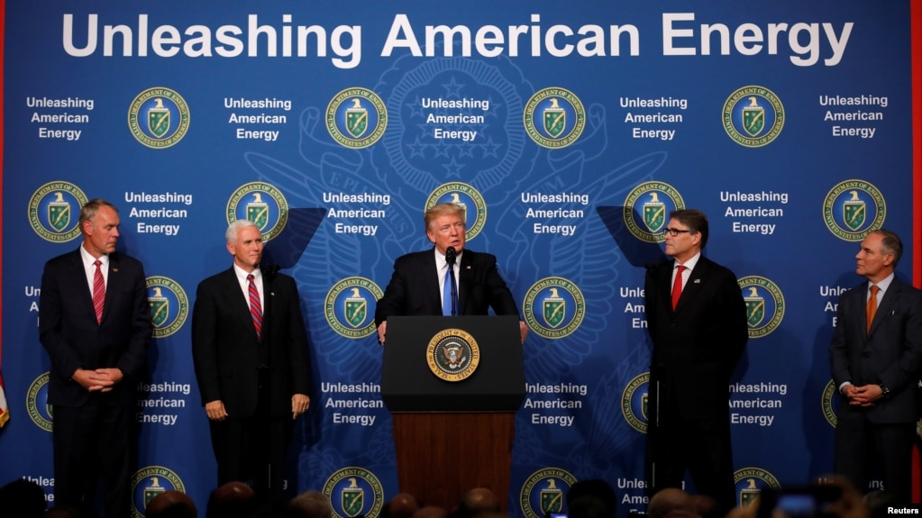
Trump's 2024 Campaign Energy Proposals
Reversing temporary pause on LNG export permits implemented by Biden
Scrapping EPA rule charging methane emissions fees to oil and gas industry
Extraction on Federal Lands
Paris Climate Agreement Exit (again)
Reduction in EV's + Tax Credits

Slide 14
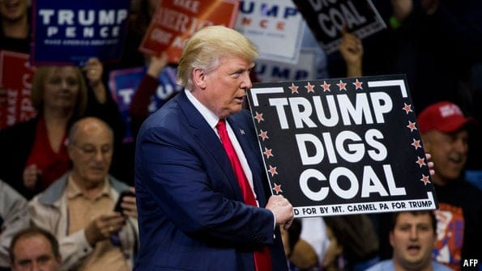
Trump's 2024 Energy Policies
Preference for fossil fuel expansion and deregulation
Hugely negative implications for climate action and renewable energy development

Slide 15
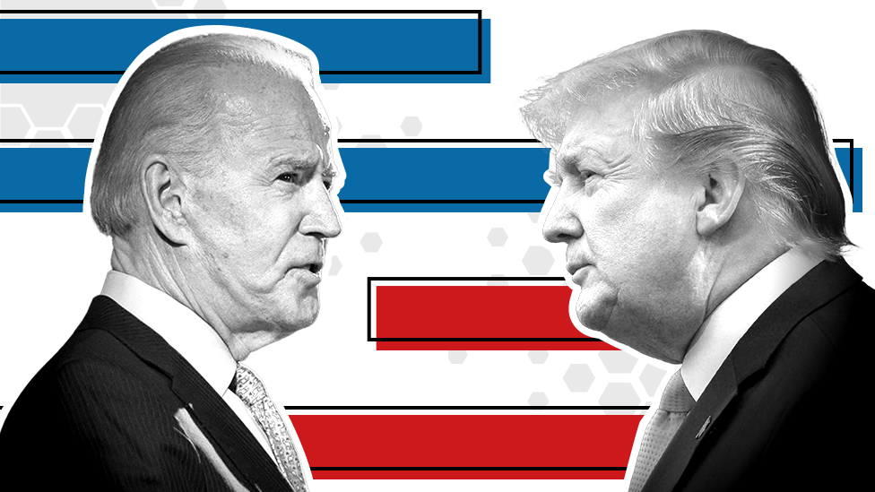
Current Energy Policy and Looking Ahead
Emissions reduction
Renewable energy action

Slide 16
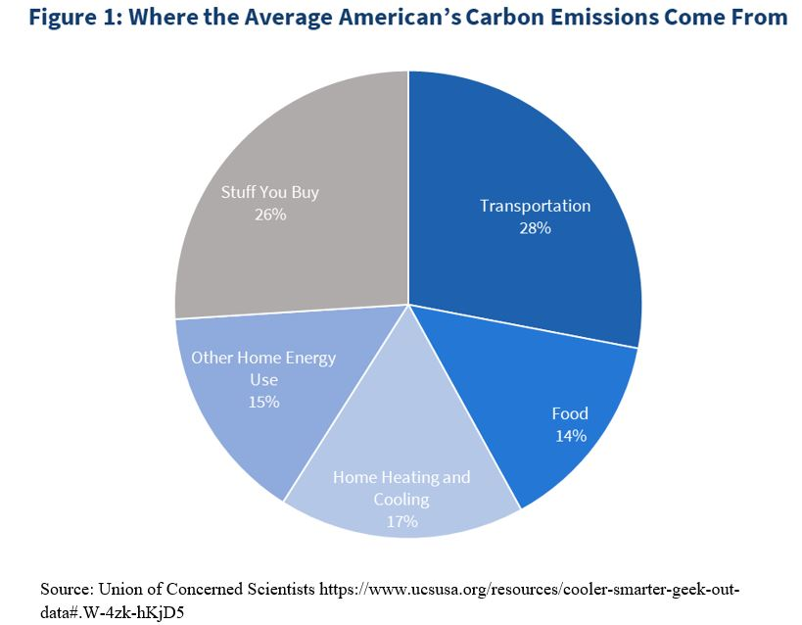
Emissions Reduction- Biden
Tailpipe pollution limits
Fully electric or hybrid vehicles
Target of zero-emissions by 2032

Slide 17
Emissions Reduction- Trump
Efficiency review of passenger cars and trucks
Safer Affordable Fuel-Efficient (SAFE)
Standards to increase emissions reductions by 1.5%

Slide 18
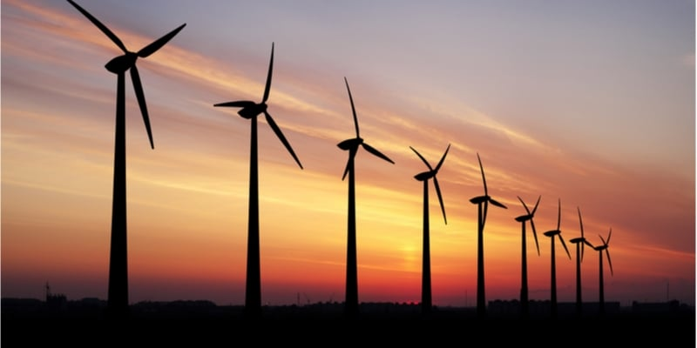
Renewable Energy Action- Biden
Goal of carbon pollution-free power sector by 2035
Offshore wind
Onshore renewable generation projects

Slide 19
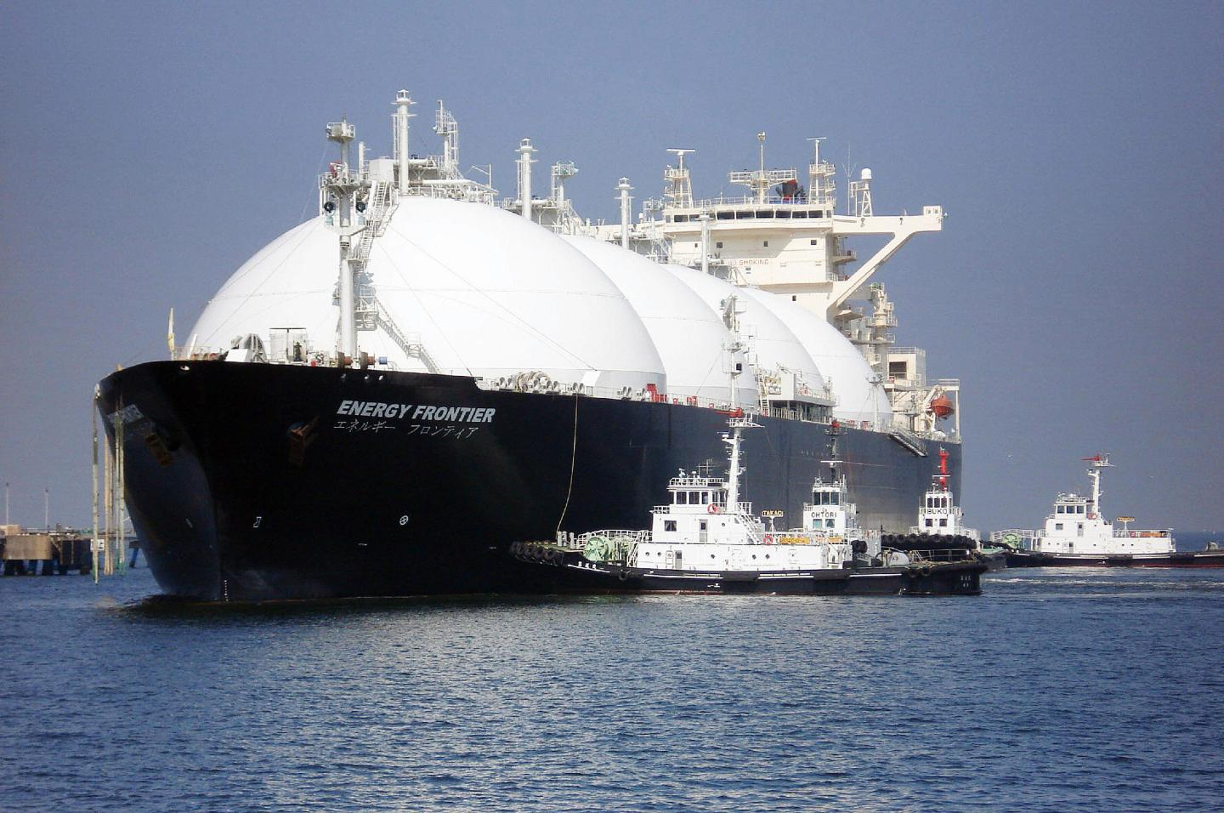
Renewable Energy Action- Trump
Government buildings, vehicles, & equipment
U.S. Natural Gas export

Slide 20
Thank you!
Stay tuned to energy policy leading up to November!
Happy Earth Month!
info@theenergy.coop
215-413-2122

Slide 21
Sources
https://www.doi.gov/pressreleases/biden-harris-administration-advances-15-onshore-clean-energy-projects-potential-power
https://trumpwhitehouse.archives.gov/wp-content/uploads/2021/01/210114-Final-Accomplishments-Document.pdf
https://www.nytimes.com/2024/02/16/climate/trump-clean-energy-fact-check.html
https://www.whitehouse.gov/cea/written-materials/2021/09/16/the-presidents-agenda-to-build-back-better-will-reduce-emissions-and-keep-energy-costs-low/
https://www.reuters.com/world/us/what-second-trump-presidency-could-mean-us-energy-policy-2024-02-16/
https://www.bbc.com/news/election-us-2020-53657174
https://fortune.com/2014/09/10/natural-gas-exports-set-to-take-off-as-energy-department-approves-two-new-projects/
https://trumpwhitehouse.archives.gov/issues/energy-environment/

